Slide 1
Plasma diagnostics and modelling

Slide 2
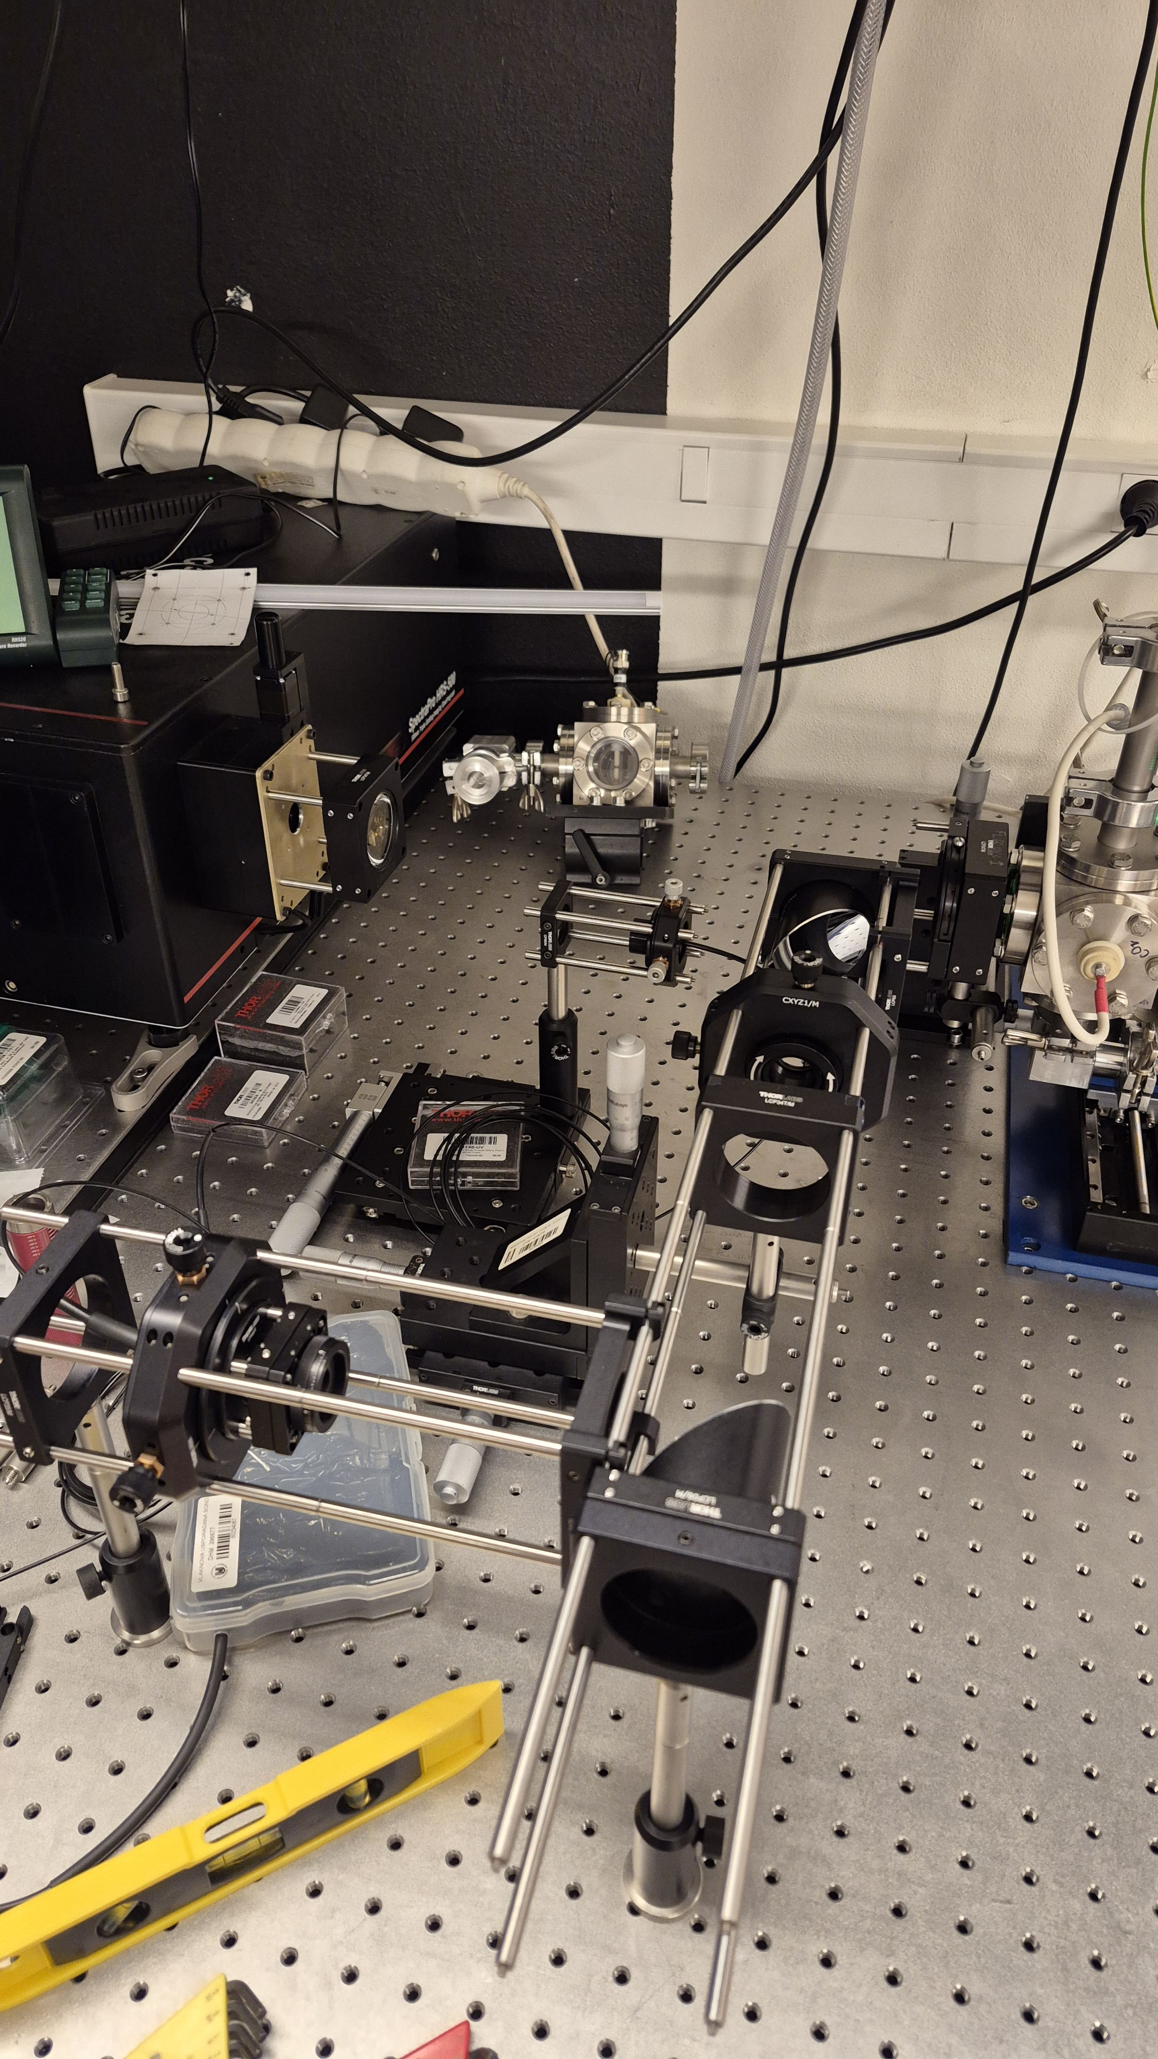
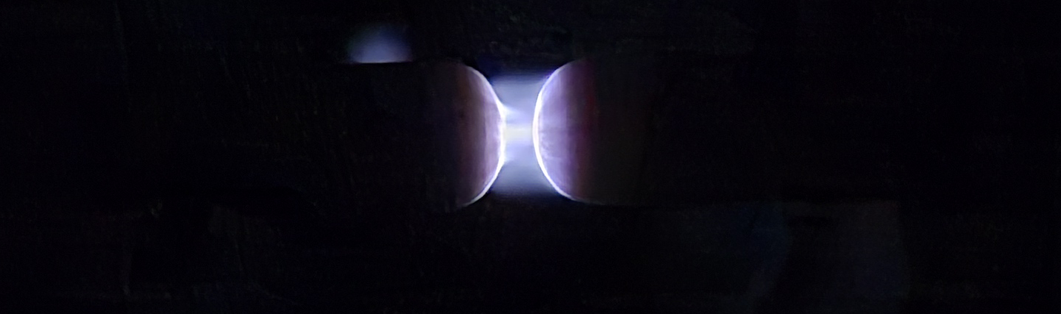
Energy transfer investigation in pure CO₂ discharge
Context
CO₂ is known as a major environmental challenge. One solution is to turn this exhaust gas into valuable resources using non-equilibrium plasmas.
However, we still lack key data to understand the energy-transfer processes occurring in atmospheric-pressure discharges.
What and how to do it
Generate a pure CO₂ plasma at atmospheric pressure
Probe the ultrafast energy-transfer processes using time-correlated single-photon counting (TCSPC) of the light emitted by the discharge.
What to learn as a student
Plasma physics and spectroscopy
Ultrafast optical diagnostics
Data analysis and numerical modelling
Contact: ronny.jeanmariedesiree@sci.muni.cz

Slide 3
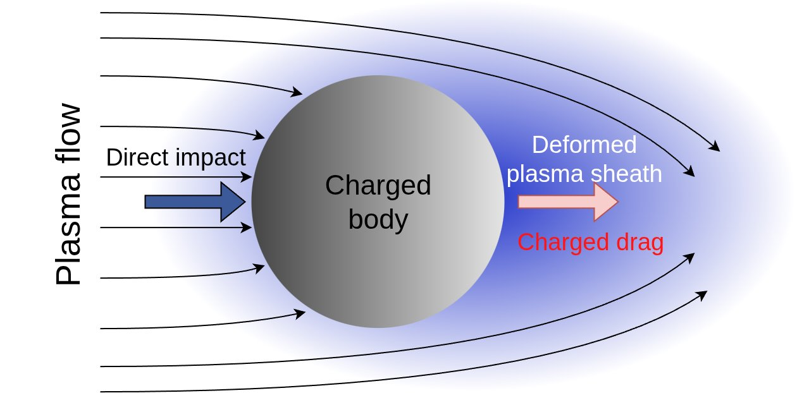
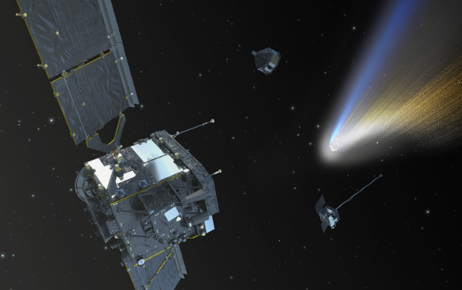
Effects of dusty plasma on spacecraft charging during high-speed flight in cometary plasma environments
Framework
Dusty plasmas consist of electrons, ions, and charged dust grains whose interactions produce complex collective effects, especially in rarefied space environments.
Such environments naturally occur in cometary comae and may influence the charging behavior of spacecraft and scientific instruments during comet exploration missions.
Objectives
Investigate the influence of charged dust grains on plasma sheath growth within rarefied high-speed regime
Validate numerical models for dusty plasma in high-speed flow
Outcomes
Plasma-charged body interactions and dynamics
Writing own code using relevant models
Introduction to advanced numerical codes
such as, PANTERA (VKI) or SPIS (SPINE/ESA)
Contact: jan.skacel@mail.muni.cz

Slide 4
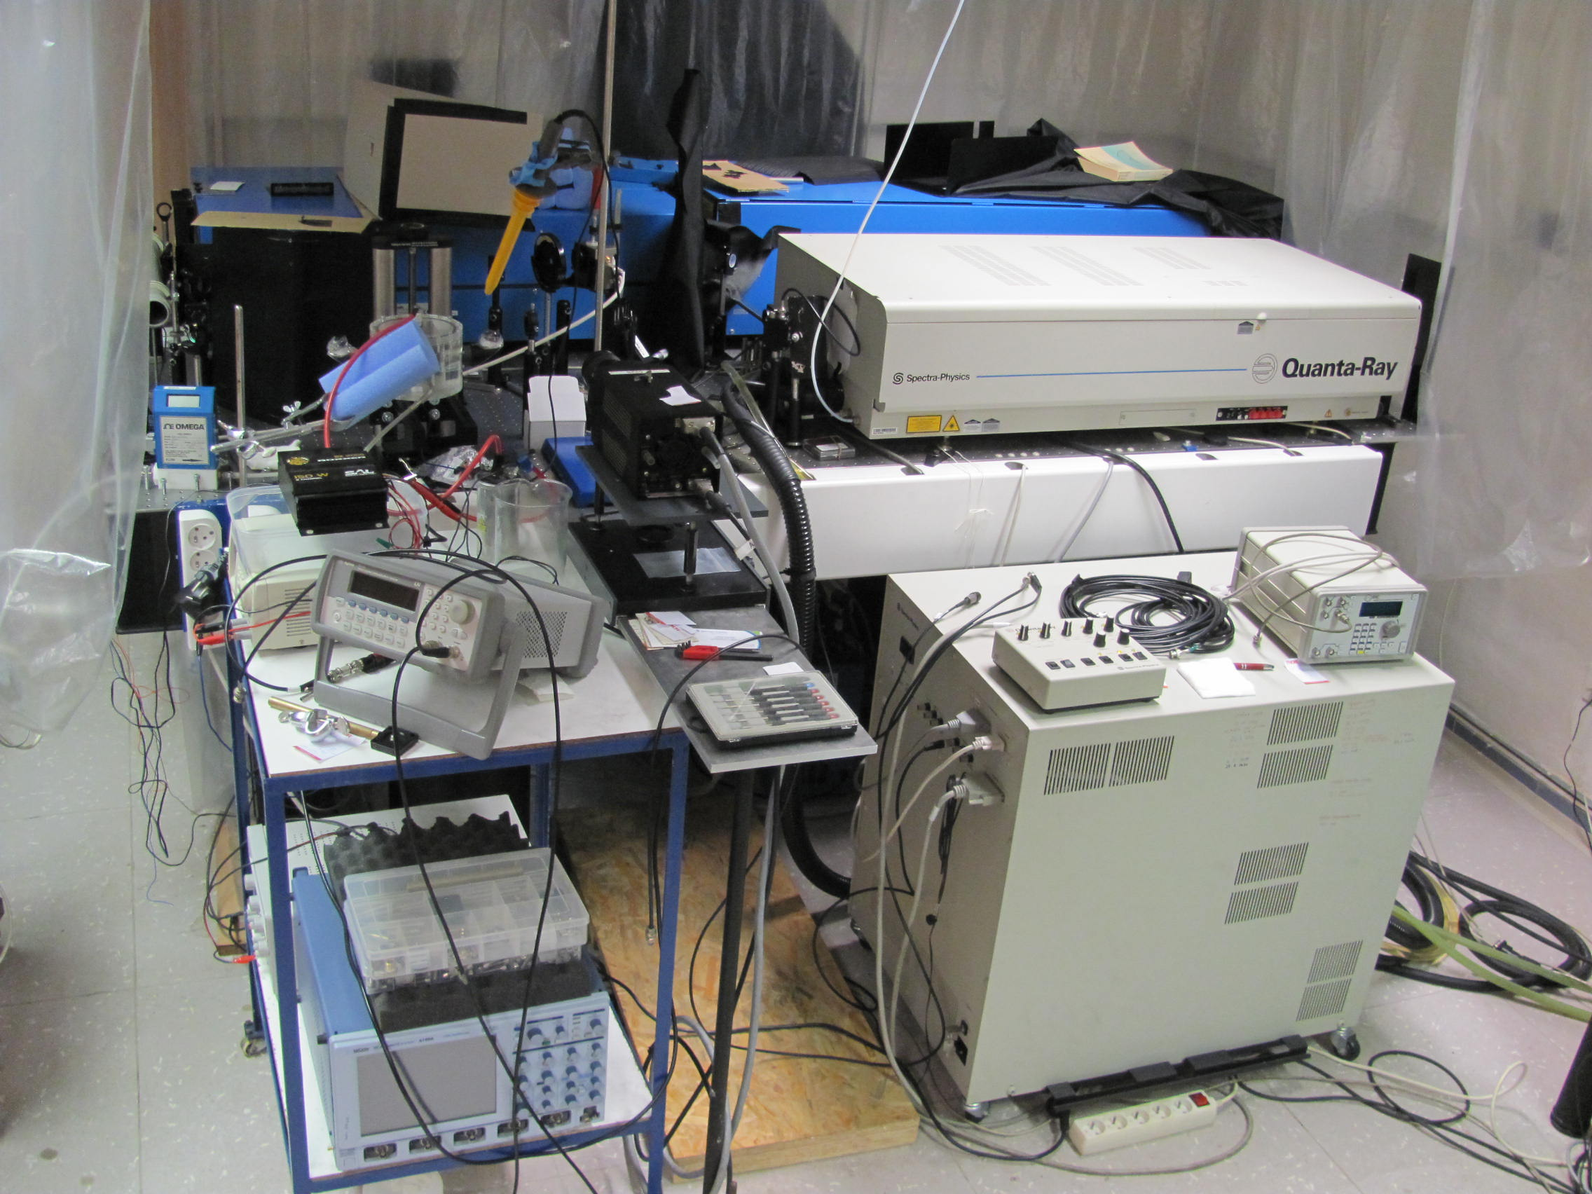
Laser-induced fluorescence for the development of atomizers
Context
To detect trace amounts of elements in solutions (As, Pb, Bi, …), atomic absorption spectrometry is suitable method. « Atomizers » play key role here, as they cut the compounds into free atoms, that can be detected by spectrometry.
Our goal is to help to develop more efficient atomizers.
What and how to do it
Work with different atomizers (electric discharges, flames, …) in different conditions
Reveal their atomization efficiencies by measurements of 3D maps of atomized particles using laser-induced fluorescence (LIF)
What to learn as a student
Plasma physics, analytical chemistry
Setting and operating experiments in the laser laboratory
Data analysis
Contact: mrkm@mail.muni.cz or pdvorak@physics.muni.cz

Slide 5
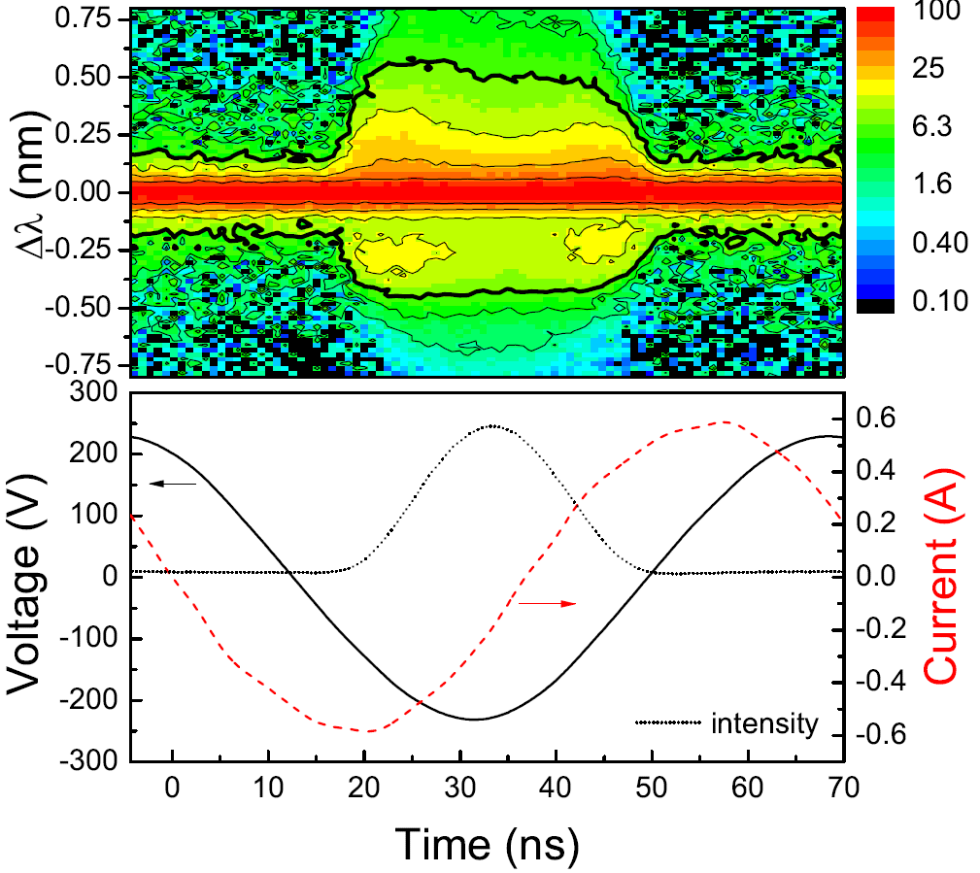
Stark polarization spectroscopy in atmospheric pressure discharges
Context
Stark polarization spectroscopy uses the electric-field-induced splitting and polarization of atomic emission lines to probe local electric fields in plasmas.
In dielectric barrier discharges in helium or neon, it can provide time-resolved information on the rapidly evolving field during individual microdischarge events.
What and how to do it
diagnostics of DBD in helium or neon using TCSPC or streak camera
Probe the ultrafast energy-transfer processes using
time-correlated single-photon counting (TCSPC)
of the light emitted by the discharge.
What to learn as a student
Plasma physics and spectroscopy
Ultrafast optical diagnostics
Data analysis and numerical modelling
Contact: zdenek@physics.muni.cz

